Slide 1

Group 3
Software Manager: Dirk Thieme
Hardware Manager: Erik Manis
Project Controller: Mohammed Ansari

Slide 2
Rover Mini Project
Summary: Use the BASYS 3 board’s built-in switches to control the speed and direction of the motors inside of a rover based on which switch is pulled.
Goals: Build a better understanding of the board, the h-bridge, and the Verilog software.

Slide 3
Last Week's Tasks
Soldering Tutorial
Mohammed and Erik finished
Dirk is going in tomorrow
We have gotten some parts in
Get a Workbench
We have workbench 1
Get an H-bridge
Choose a circuit simulator
We familiarized ourselves with LTspice
Watch Verilog tutorials
Set up a GitLab repo to manage all our project files and information

Slide 4
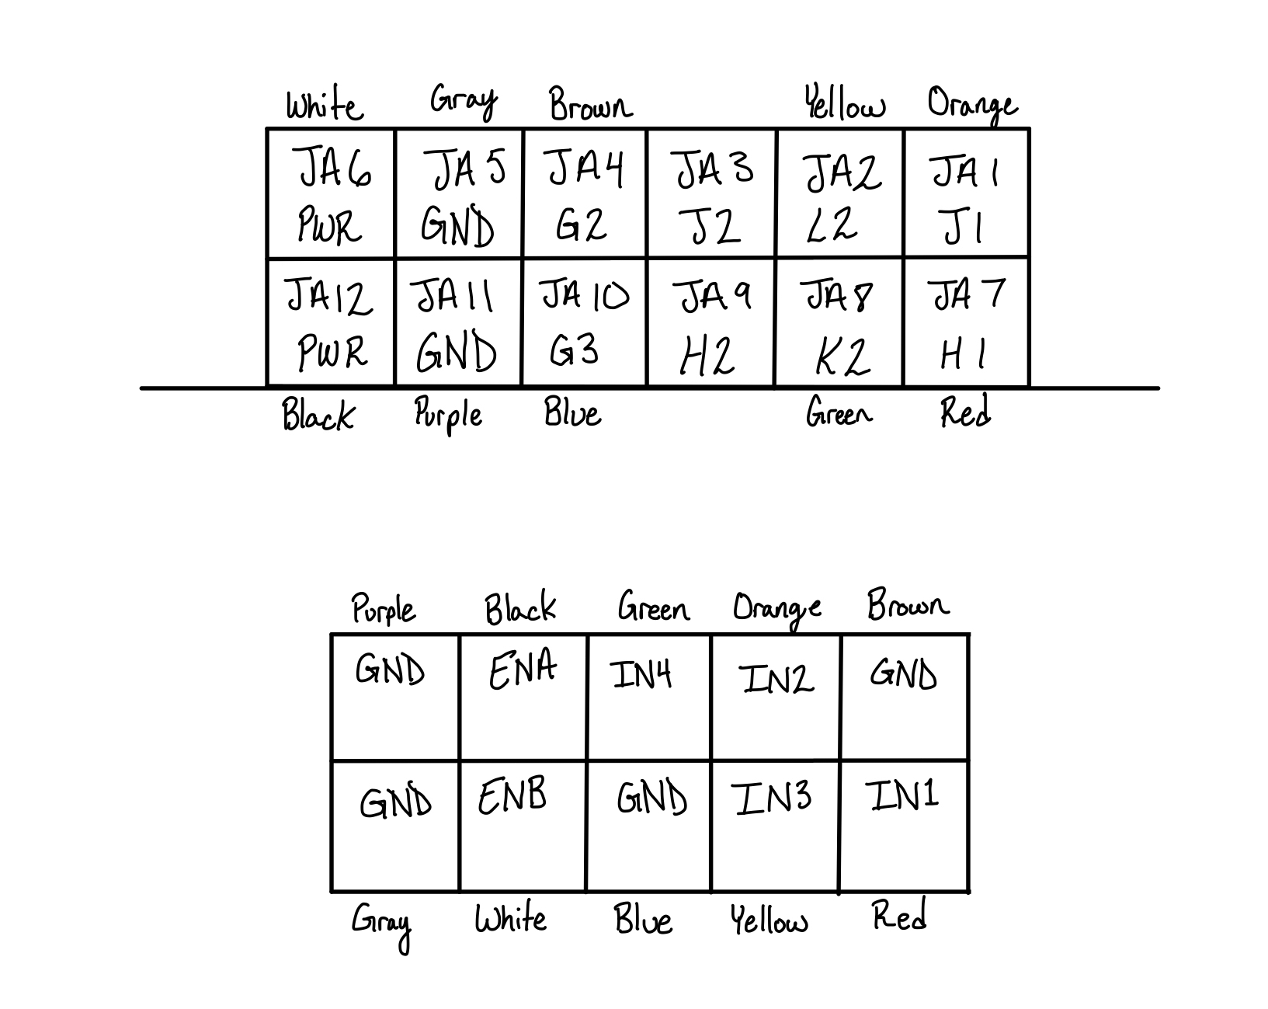
Hardware Update
PMOD

Slide 5
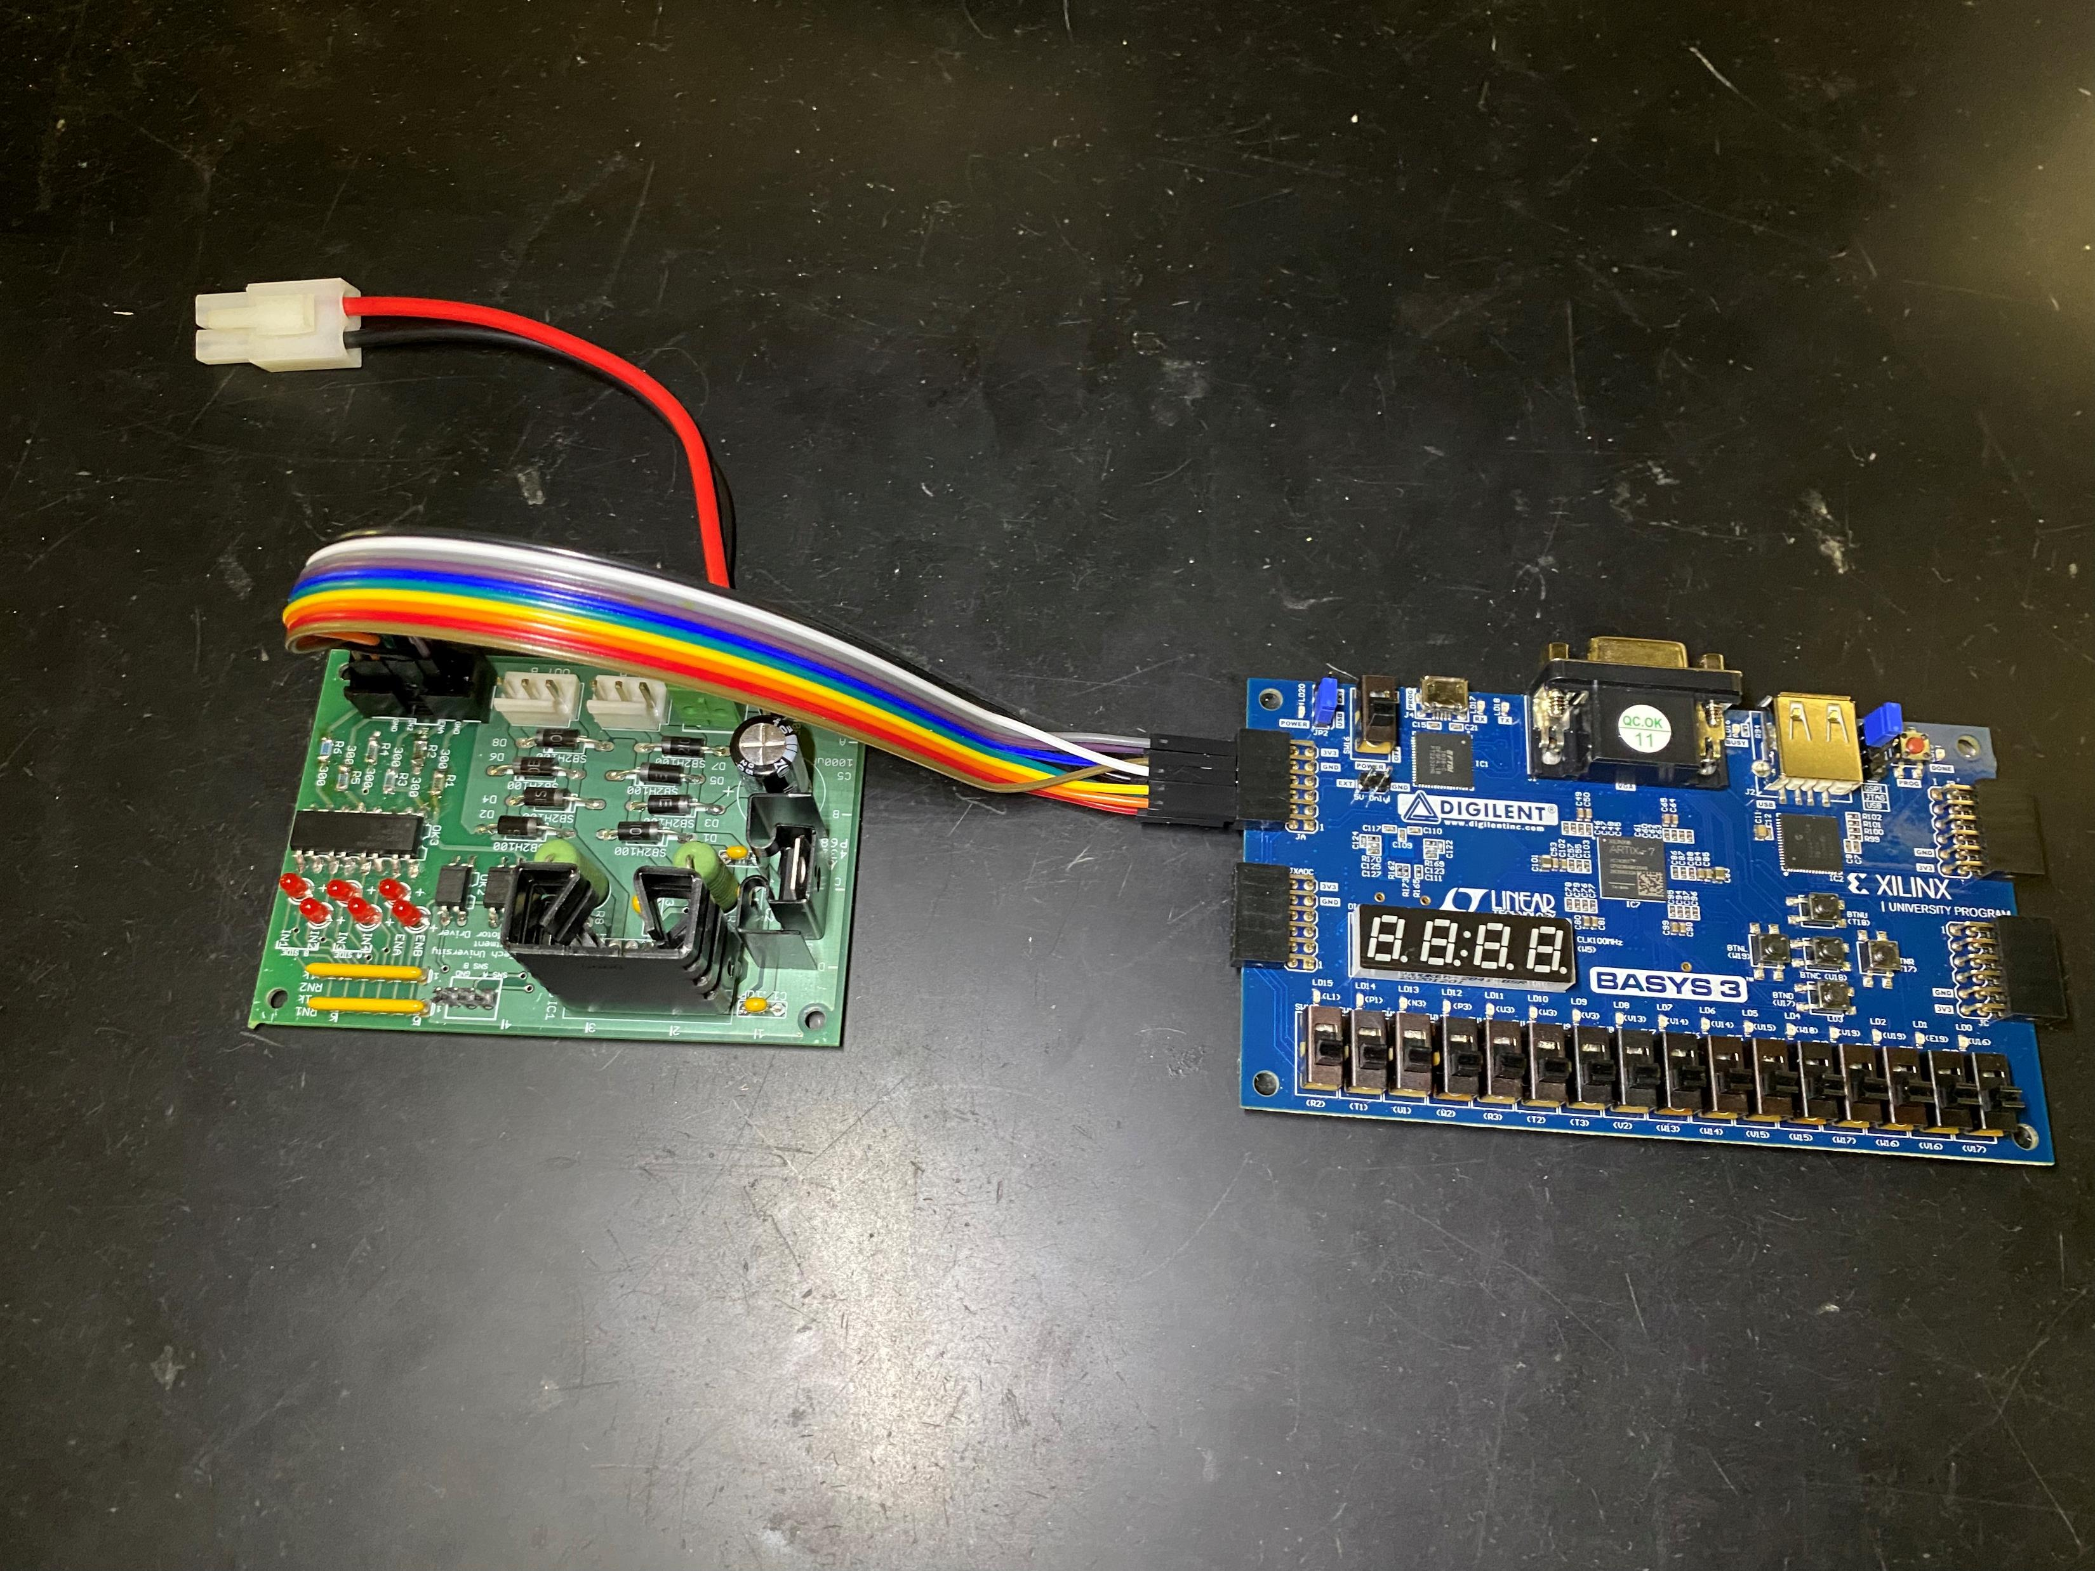
Hardware Update
PMOD

Slide 6
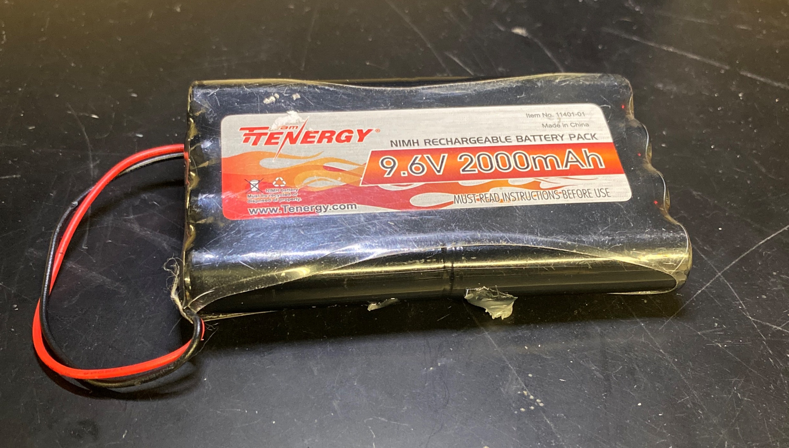
Hardware Update
The Battery
9.6V 2,000mAh
(Actually 11.6V)

Slide 7
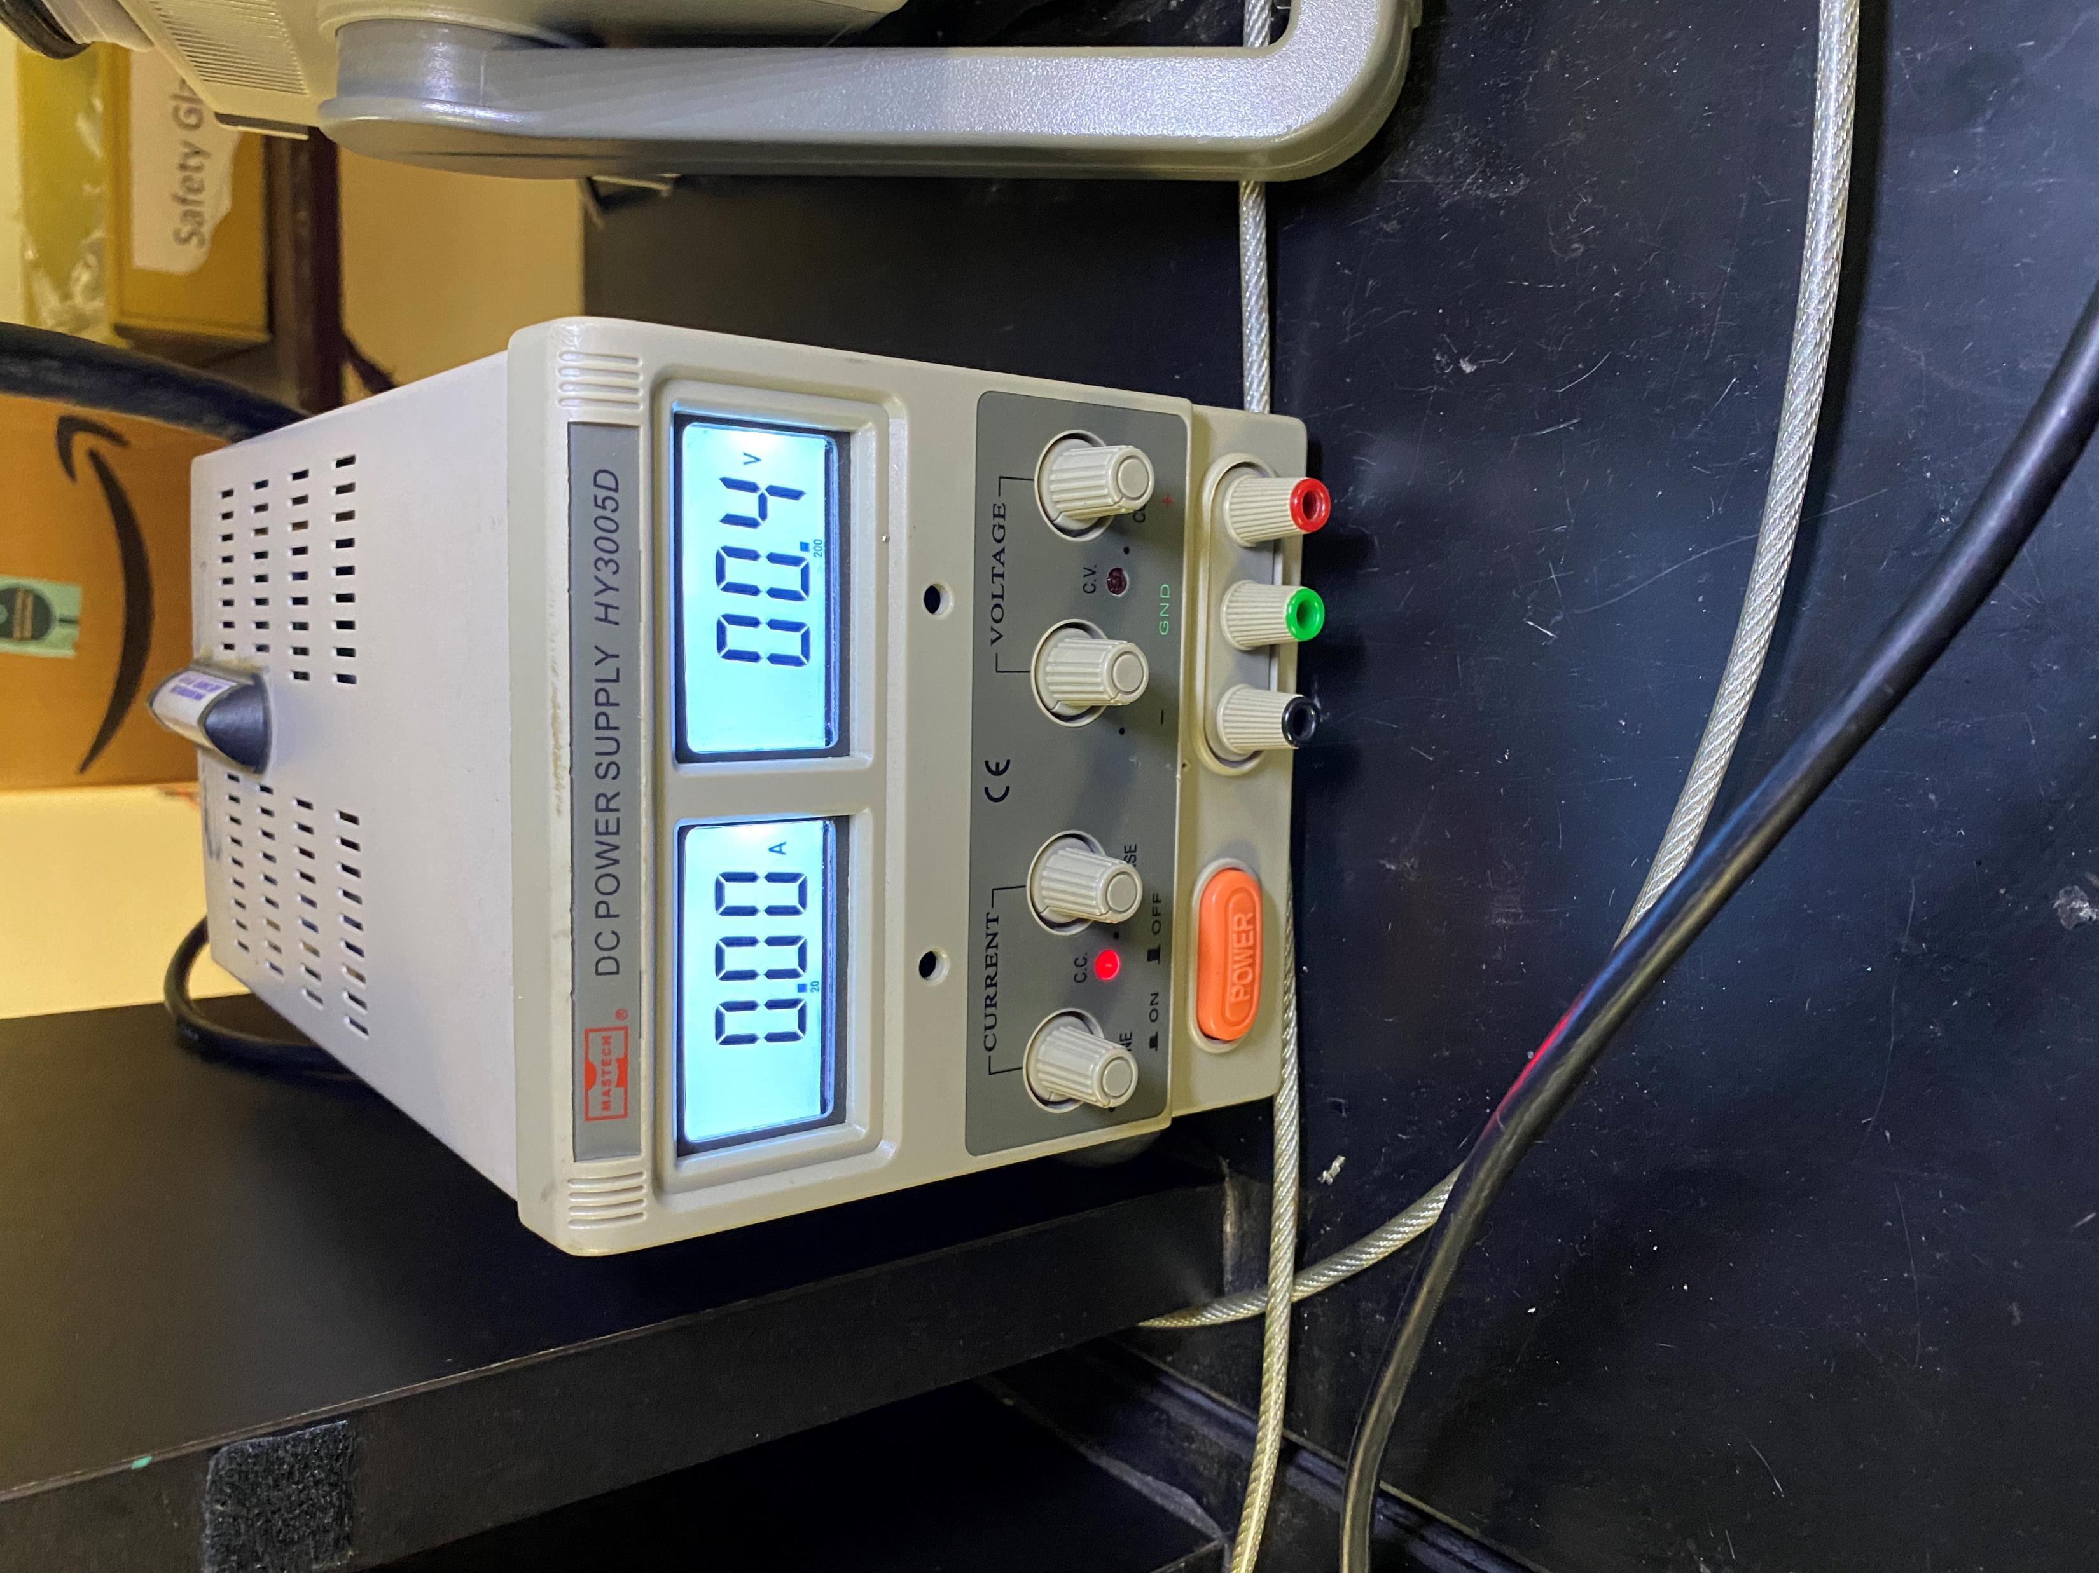
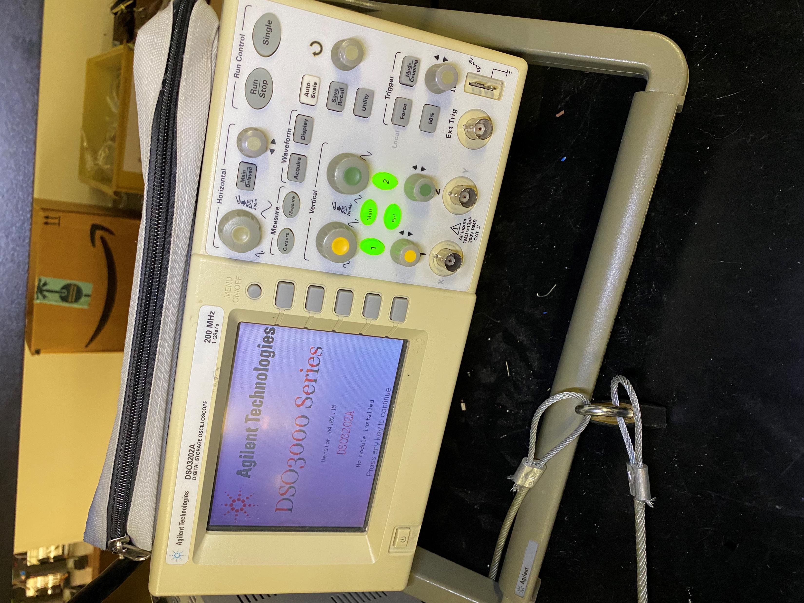
Hardware Update
All the lab equipment has been tested. I used the function generator to test the o-scope. I also used the power source to test the multimeter.

Slide 8
Hardware Update
I tested the rover to see if it was functioning at the very least. I hooked up the power supply to test the rotors. I used 5 volts and they pulled about 0.3 amps. I made sure to test both rotors, in both directions to make sure everything is running smoothly.

Slide 9
Hardware Update
We obtained all the parts necessary for the rover and we are going to start making an enclosure for the boards, so they are not bumped or damaged.

Slide 10
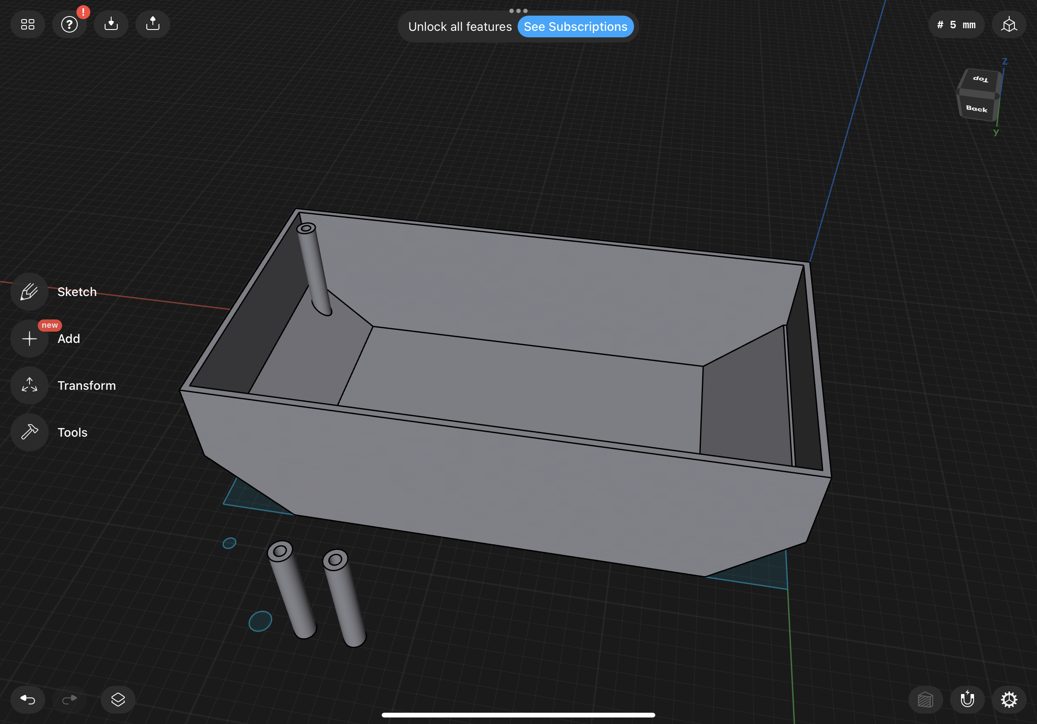
Hardware Update

Slide 11
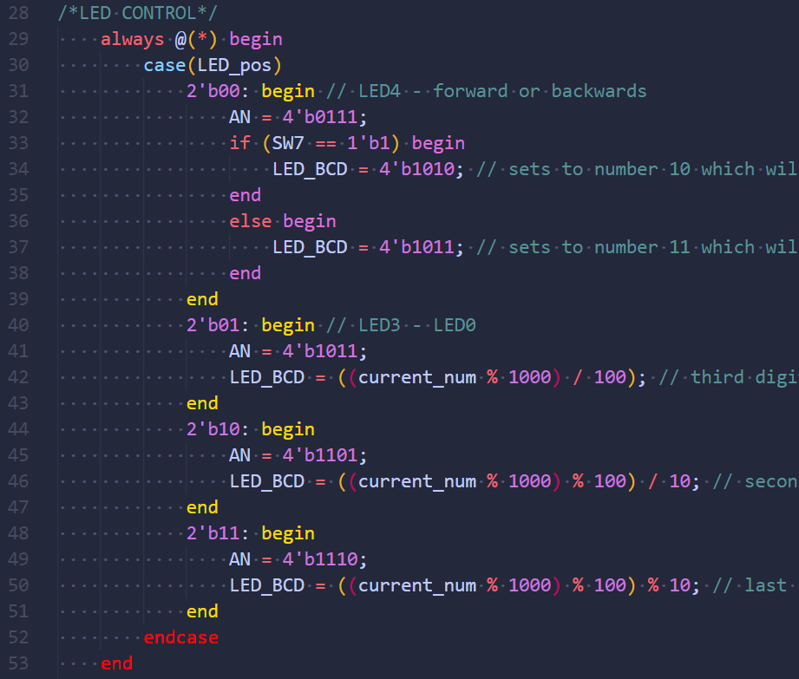
Software Update

Slide 12
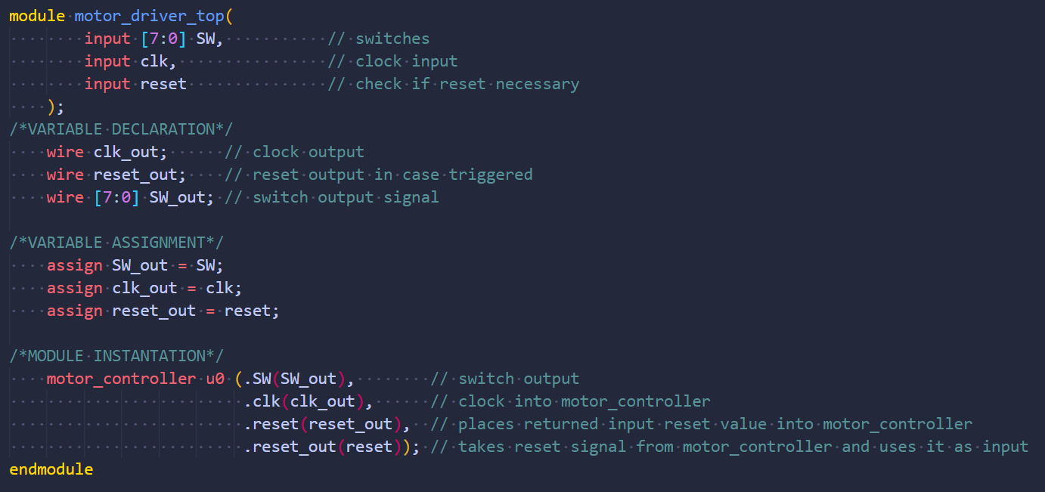
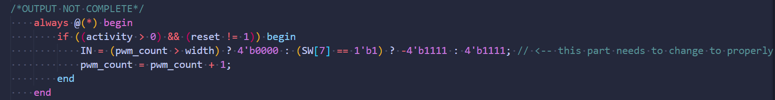
Software Update

Slide 13
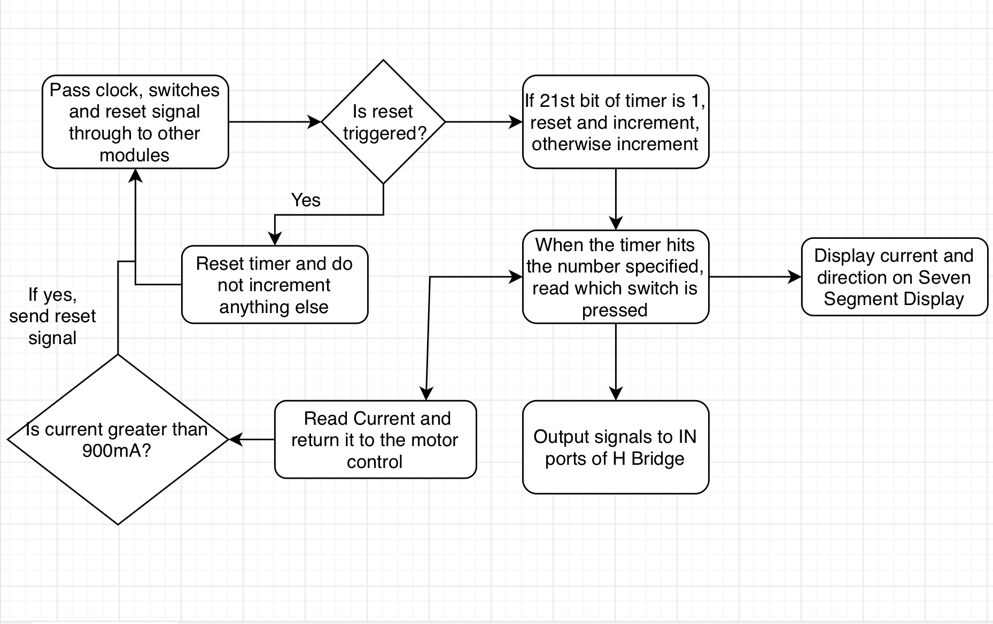
Software Update

Slide 14
Gantt

Slide 15
Overall Budget

Slide 16
Labor Costs

Slide 17
Material Costs

Slide 18
Next Week's Tasks
Finalize a rover design
Get a running test bench
Get CPR certifications
Testing the rover for defects in software or hardware

Slide 19

Questions
Software Manager: Dirk Thieme
Hardware Manager: Erik Manis
Project Controller: Mohammed Ansari
This Photo by Unknown author is licensed under CC BY.

